Slide 1
From Chef to Docker
A Saner Management for a Multi-facet Development Environment

Slide 2

Whoami
Yoav Landman
JFrog CTO

Slide 3

What Frog?

Slide 4

What Frog?

Slide 5

What Frog?

Slide 6

What Frog?

Slide 7

So…

Slide 8











Bintray
Distribution as a service

Slide 9
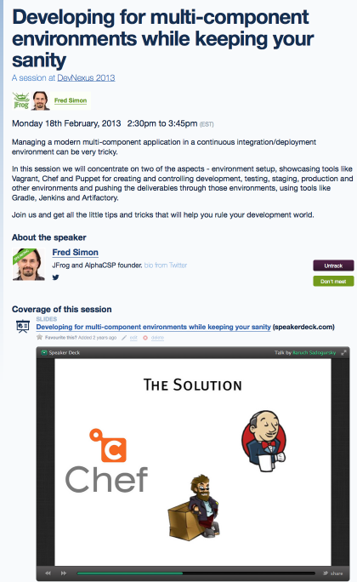
Remember 2013

Slide 10







Diverse technologies

Slide 11

We are liberal

Slide 12

We are liberal

Slide 13

We are liberal

Slide 14


Slide 15
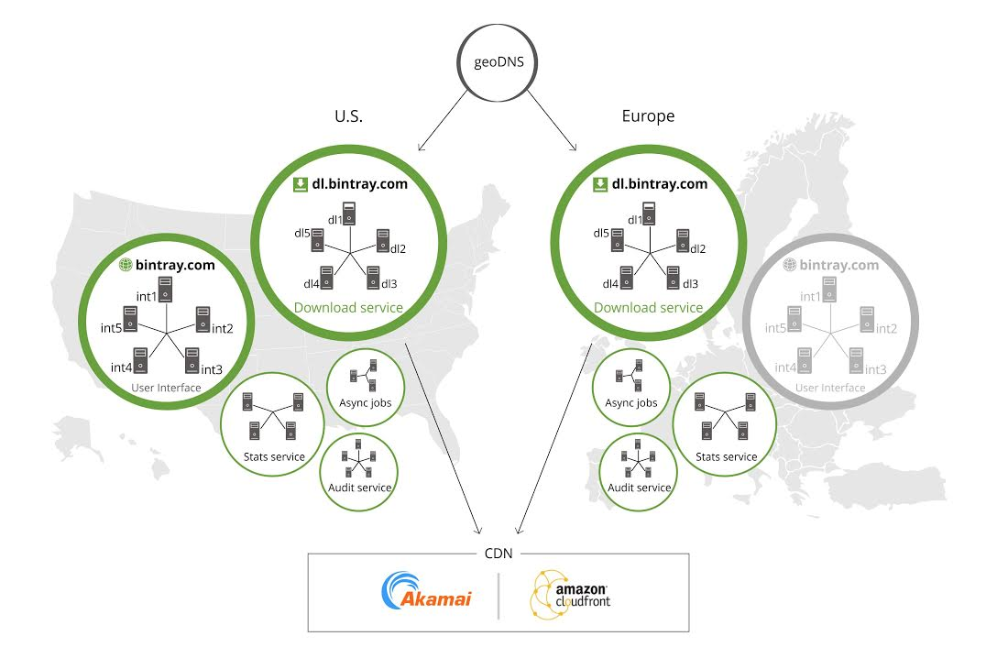

Slide 16


Slide 17

OK, we have an idea

Slide 18


The Solution
+

Slide 19
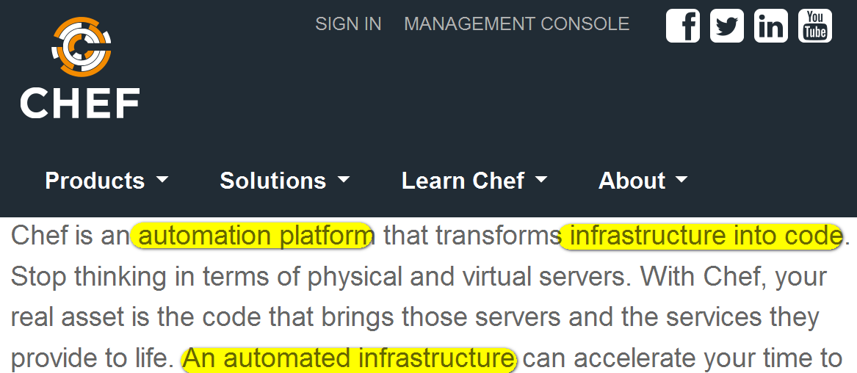
Opscode Chef

Slide 20
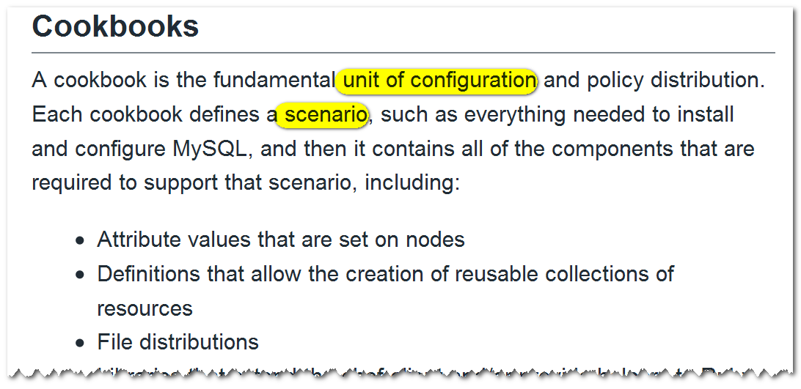
Chef works with cookbooks

Slide 21
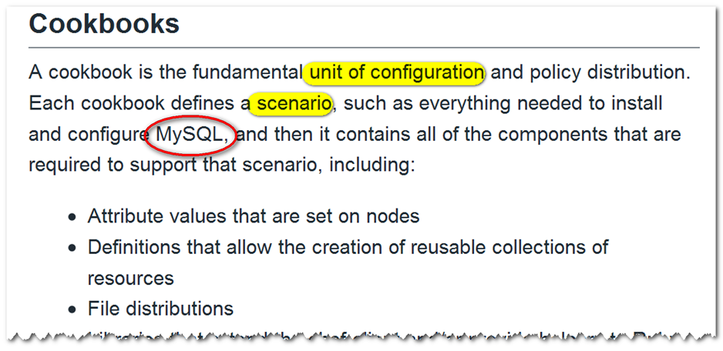
Chef works with cookbooks

Slide 22
Example: Install MySQL in Ruby

Slide 23
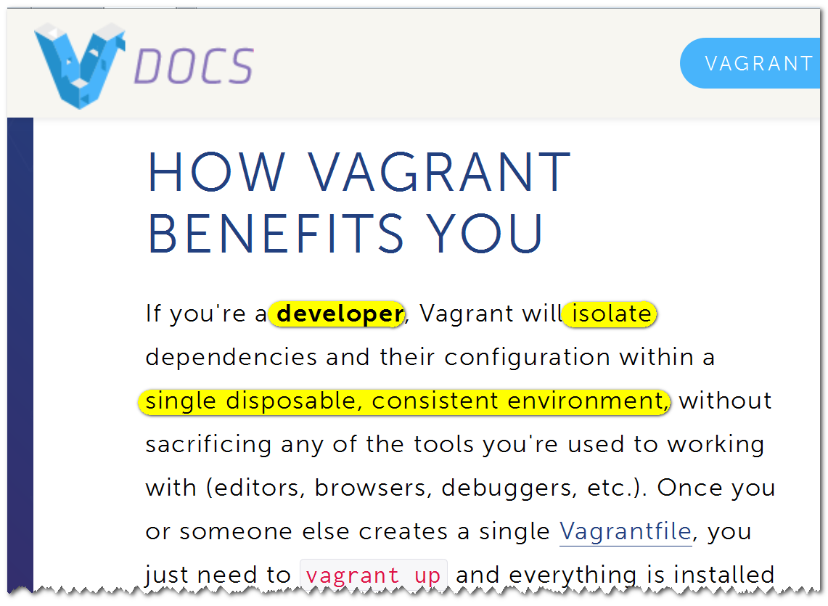
Vagrant

Slide 24
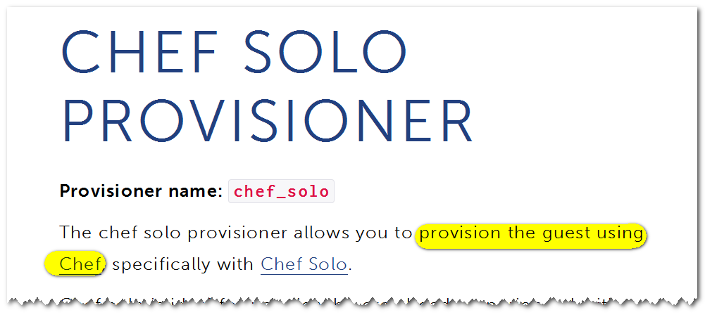
Setup Vagrant with Chef

Slide 25
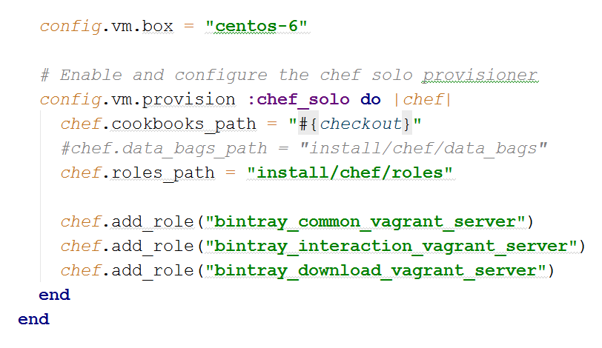
Setup Vagrant with Chef

Slide 26
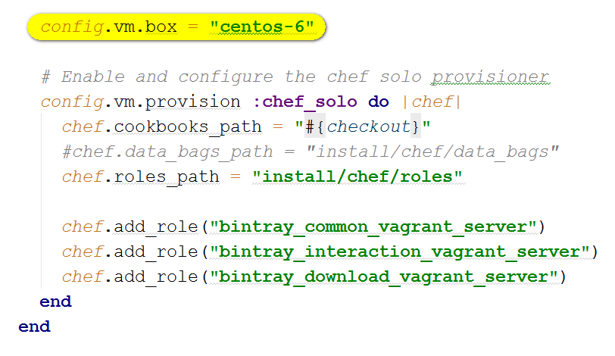
Setup Vagrant with Chef

Slide 27
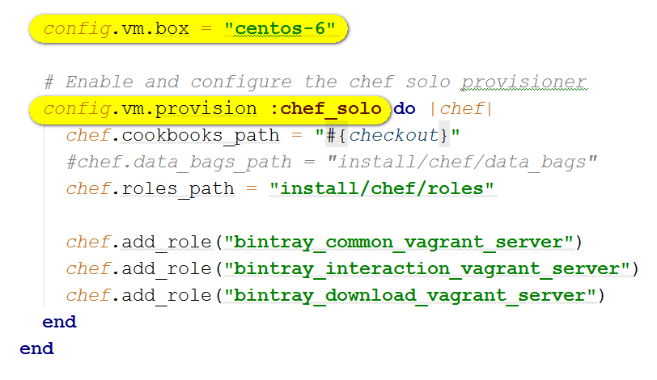
Setup Vagrant with Chef

Slide 28
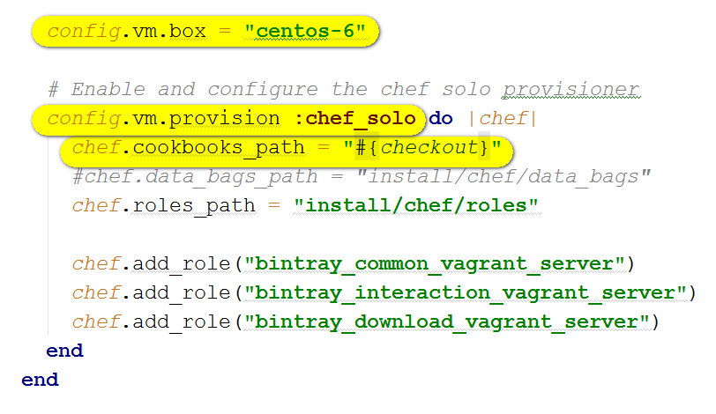
Setup Vagrant with Chef

Slide 29
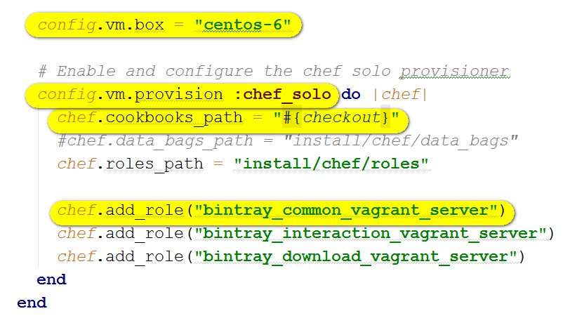
Setup Vagrant with Chef

Slide 30

How it works

Slide 31
How it works
Check out cookbook and vagrant file

Slide 32
How it works
Check out cookbook and vagrant file
Vagrant downloads box

Slide 33
How it works
Check out cookbook and vagrant file
Vagrant downloads box
Vagrant starts the box

Slide 34
How it works
Check out cookbook and vagrant file
Vagrant downloads box
Vagrant starts the box
Vagrant triggers Chef

Slide 35
How it works
Check out cookbook and vagrant file
Vagrant downloads box
Vagrant starts the box
Vagrant triggers Chef
Chef plays recipes to set up everything

Slide 36
How did we like it?
Solves the problem!
Notes:
Pros:
Solves the problem!
Cons:
Devs ruin stuff
Recipes depend on state
Partial rerun is almost impossible
Replaying all the recipes takes ages

Slide 37
CentOS 6
VirtualBox
Provider
mongo
Vagrant
couch
Chef
provision
elastic
...

Slide 38

But…
Notes:
Pros:
Solves the problem!
Cons:
Devs ruin stuff
Recipes depend on state
Partial rerun is almost impossible
Replaying all the recipes takes ages

Slide 39

Developers break things

Slide 40

One does not simply
Replay all chef recipes
Notes:
State!

Slide 41

I am not slacking off, my environment is provisioned
Notes:
August 15, 2007 – compiling 5 years later – playing recipes

Slide 42
Solution I:
Pre-build instead of build

Slide 43
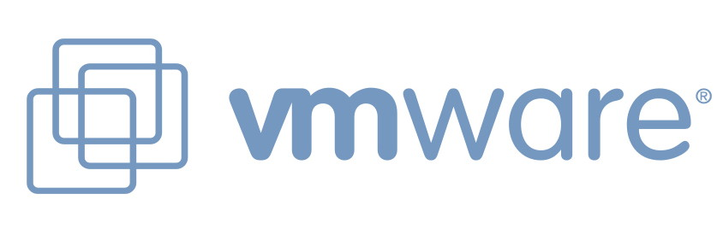


Not really new idea
Notes:
Who else?

Slide 44
How it works

Slide 45
How it works
Vagrant downloads box

Slide 46
How it works
Vagrant downloads box
Vagrant starts the box

Slide 47
How it works
Vagrant downloads box
Vagrant starts the box
Everything is up and running!

Slide 48

How did we like it?
Solves the problem!
Notes:
Pros:
Solves the problem!
Cons:
Devs ruin stuff
Recipes depend on state
Partial rerun is almost impossible
Replaying all the recipes takes ages

Slide 49

But every time something changing in the environment…

Slide 50
One does not simply
Rebuild vm on every change

Slide 51
OK, we have an idea

Slide 52

automate
All the things

Slide 53
Automating vm creation

Slide 54
Automating vm creation
Chef?

Slide 55
Automating vm creation
Packer?

Slide 56
Automating vm creation
docker?

Slide 57

Docker
Docker everywhere

Slide 58
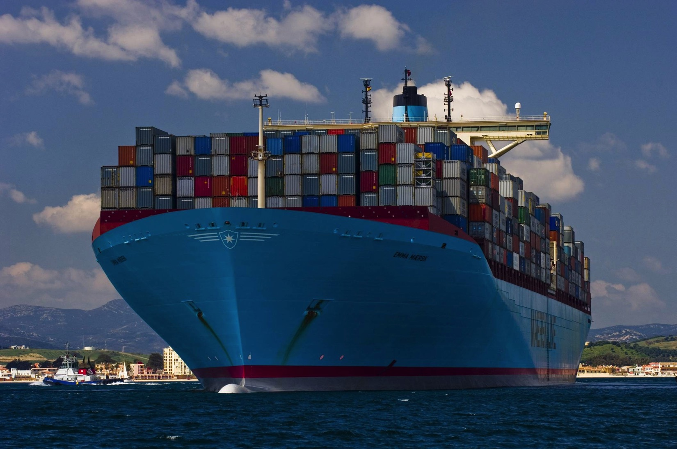
Why docker?
Because containers.

Slide 59
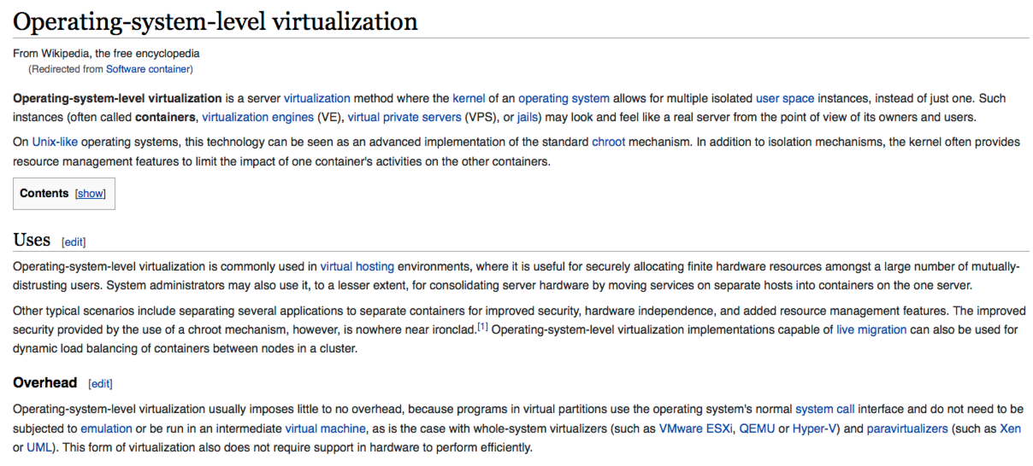

Slide 60
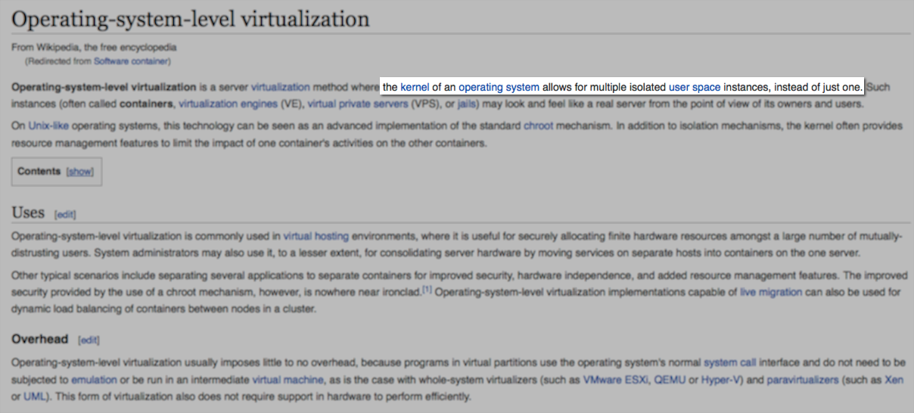

Slide 61
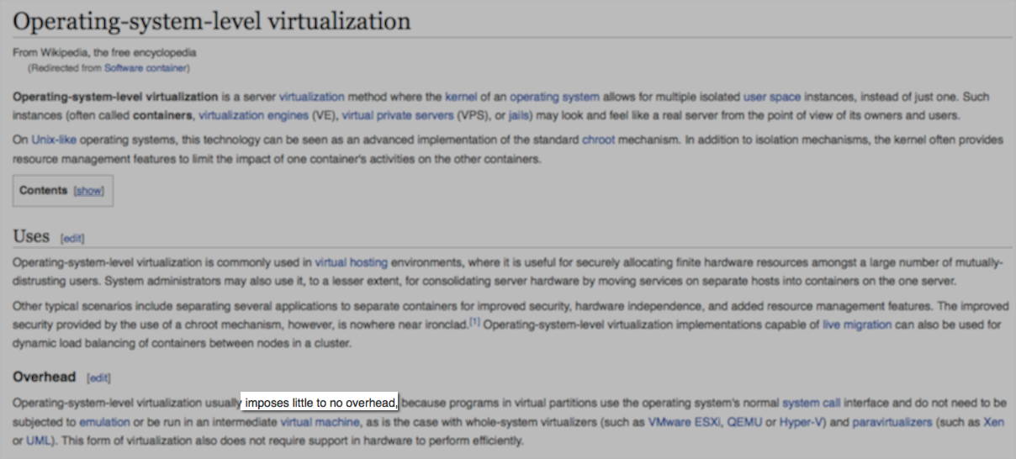

Slide 62
http://www.programering.com/a/MDMzAjMwATk.html

Slide 63
Layered approach
Along other benefits, efficient:
Docker pull brings deltas only

Slide 64
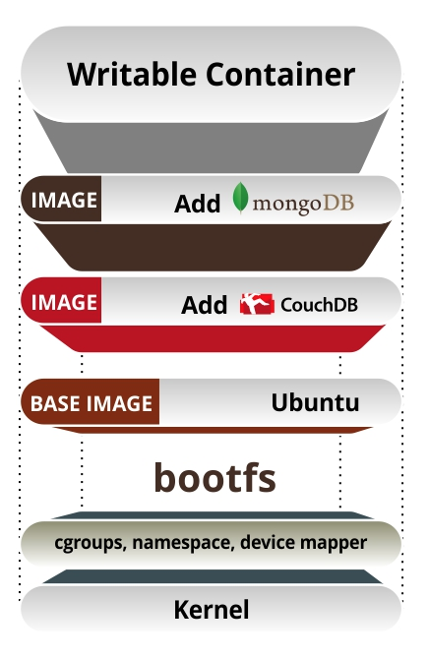

Slide 65
Docker microservices
Docker fits much the micro-service arch of bintray (+ we do not need all services always)

Slide 66
Docker is not enough

Slide 67

Docker is not enough

Slide 68
Docker is not enough
automate
All the things

Slide 69
Why Vagrant and Docker
Configure host vm to run containers
Plugable Docker hosts
Install Docker and run Docker
Vagrant can control Docker containers – run, destroy, link
Notes:
Configure it once and run it everywhere : Vagrant is just a Docker wrapper on systems that support Docker natively while it spins up a "host VM" to run containers on systems that don't support it. User don't have to care weather Docker is supported natively or not : the same configuration will work on every OS.
Docker hosts are not limited to boot2docker (a Virtualbox image of Tiny Core Linux) but Debian, Ubuntu, CoreOS and other Linux distros are supported too. And can run can run on more stable VM managers than Virtualbox (e.g. VMWare).
Vagrant can orchestrate Docker containers: run multiple containers concurrently and link them together
Docker hosts are not limited to boot2docker (a Virtualbox image of Tiny Core Linux) but Debian, Ubuntu, CoreOS and other Linux distros are supported too. And can run can run on more stable VM managers than Virtualbox (e.g. VMWare).
Vagrant can orchestrate Docker containers: run multiple containers concurrently and link them together

Slide 70
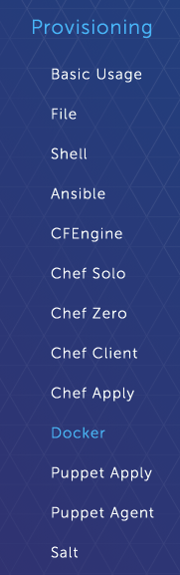
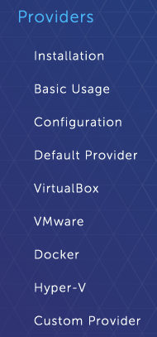
Docker support in Vagrant
?

Slide 71

Provider? Provisioner?

Slide 72
Provider vs Provisioner
Provider: defines the type of machines to manage, affects vm creation
Provisioner: configures an existing machine on first vagrant up
Vagrant destroy - undo machine creation

Slide 73
Solution II:
Vagrant + Docker All the services in one container

Slide 74
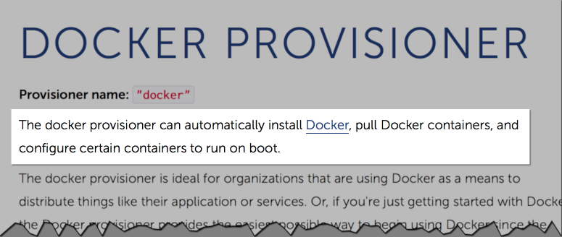

Slide 75
CentOS 6
VirtualBox
Provider
Container
Vagrant
mongo
Docker provision
couch
elastic
...

Slide 76
Vagrant.configure("2") do |config|
config.vm.box = "centos6”
config.vm.provider :virtualbox do |vb|
vb.gui = false
end
...
config.vm.provision "docker" do |d|
d.pull_images "jfrog/bintray"
d.run "jfrog/bintray"
end
end

Slide 77
CentOS 6
VirtualBox
Provider
Container
Vagrant
mongo
Service Manager
???
Docker provision
couch
elastic
...

Slide 78
One single container or multiple containers - with one you also need to add a process manager; for instance Monit or Supervisor.

Slide 79
OK, we have an idea

Slide 80
Solution III:
Vagrant + Docker Separate containers with Vagrant provisioners

Slide 81
CentOS 6
VirtualBox
Provider
Container
Vagrant
mongo
Docker provision
Container
couch
Container
elastic

Slide 82
Vagrant.configure("2") do |config|
config.vm.box = "centos6”
config.vm.provider :virtualbox do |vb|
vb.gui = false
end
...
config.vm.provision "docker" do |d|
d.pull_images "jfrog/mongo"
d.run "jfrog/mongo”
d.pull_images "jfrog/couch"
d.run "jfrog/couch”
end
end

Slide 83
But…
Notes:
Pros:
Solves the problem!
Cons:
Devs ruin stuff
Recipes depend on state
Partial rerun is almost impossible
Replaying all the recipes takes ages

Slide 84
Developers break things

Slide 85
vagrant destroy
Remember, vagrant destroy undoes the box completely
I.E. empty box, no images, no configuration
Next vagrant up will download all the images from scratch (specially painful over VPN)

Slide 86
Solution IV:
Vagrant + Docker Separate containers with Vagrant providers
& use vagrant provider-management

Slide 87
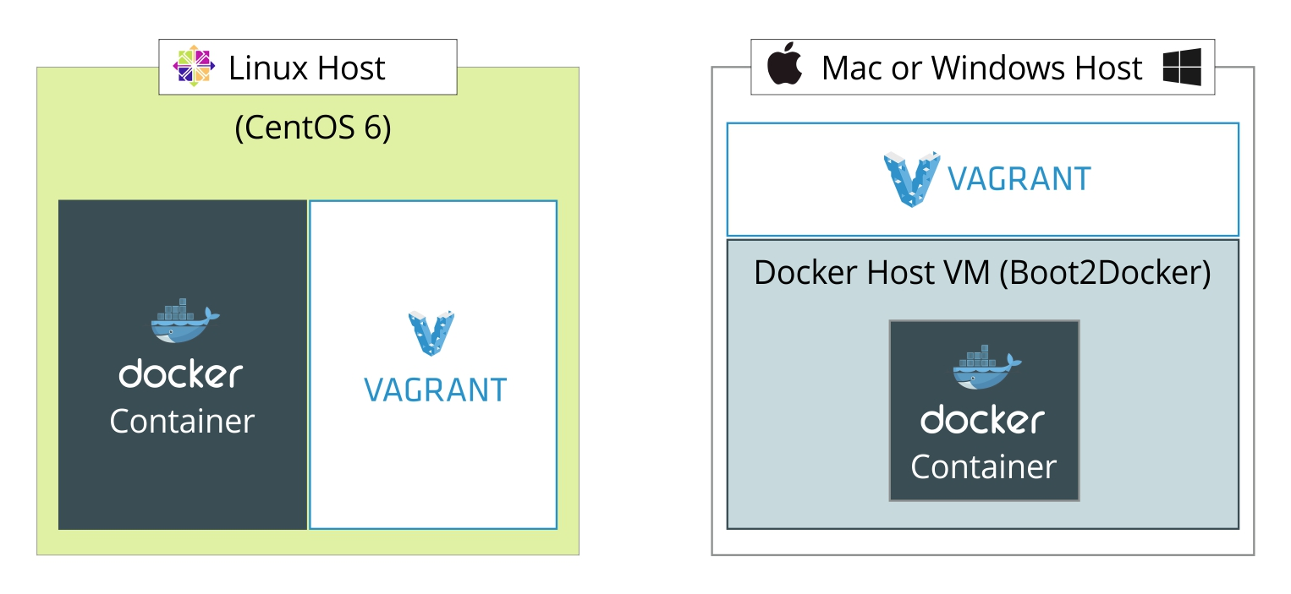
Vagrant is smart!

Slide 88
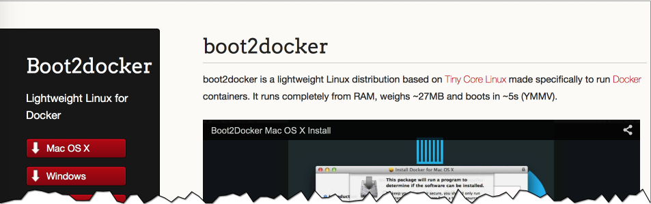
Tiny Core Linux (a.k.a. boot2docker)

Slide 89
Host OS
optionally spin up on mac/win
boot2docker
Container
Vagrant
mongo
Docker provider
Container
couch
Container
elastic

Slide 90
Vagrant.configure("2") do |config|
//Look ma, no box!
config.vm.define "mongodb" do |container|
container.vm.provider "docker" do |d|
...
end
end
config.vm.define "couch" do |container|
container.vm.provider "docker" do |d|
...
end
end
end

Slide 91

How did we like it?

Slide 92
But…
Notes:
Pros:
Solves the problem!
Cons:
Devs ruin stuff
Recipes depend on state
Partial rerun is almost impossible
Replaying all the recipes takes ages

Slide 93
The problem is right here:
Notes:
+ polluting machine-level docker on linux

Slide 94
OK, we have an idea

Slide 95
Solution V:
Vagrant + Docker Give up on boot2docker, use a box provider

Slide 96
Host OS
Docker Provision with vagrant_ vagrantfile
centos6
Container
Vagrant
mongo
Docker provider
Container
couch
Container
elastic

Slide 97
Vagrant.configure("2") do |config|
//Look ma, box is back!
HOST_VAGRANTFILE = "#{checkout}/docker/Vagrantfile"
config.vm.define "mongodb" do |container|
container.vm.provider "docker" do |d|
d.image = "#{repo_url}/bintray/mongo:2.6”
d.vagrant_vagrantfile = "#{HOST_VAGRANTFILE}"
...
end
end
config.vm.define "couch" do |container|
container.vm.provider "docker" do |d|
d.image = "#{repo_url}/bintray/couchdb:1.6.0”
d.vagrant_vagrantfile = "#{HOST_VAGRANTFILE}"
...
end
end
end

Slide 98
Vagrant.configure("2") do |config|
config.vm.provision "docker"
config.vm.define "dockerhost"
config.vm.box = "dockerhost"
config.vm.box_url = "http://repo-local:8081/artifactory/bintray-resolver/dockerhost-centos6.box"
config.vm.box_download_checksum ="4ee5de076da2a4e1c7ecc7f201f408bb"
config.vm.box_download_checksum_type = "md5"
config.vm.synced_folder "../", "/vagrant", create: true
config.vm.network "forwarded_port", guest: 5984, host: 5984
...
config.vm.provider :virtualbox do |vb|
vb.name = "dockerhost"
vb.customize ["modifyvm", :id,"--cpus", 2,"--memory", 1512]
end
end

Slide 99

How did we like it?

Slide 100
But…
Notes:
Pros:
Solves the problem!
Cons:
Devs ruin stuff
Recipes depend on state
Partial rerun is almost impossible
Replaying all the recipes takes ages

Slide 101
Race condition on vagrant up
When running multiple providers in the same vagrantfile, must use: --no-parallel
SSHing to and destroying host vm is not trivial
Devs started to get to know (and like) Docker
Notes:
∂

Slide 102
Official B2D is not up to date
We want to use fork: https://github.com/YungSang/boot2docker-vagrant-box
Notes:
∂

Slide 103
OK, we have an idea

Slide 104
Solution VI:
Vagrant + Docker Full control: Make b2d and images part of the box

Slide 105
YungSang’s boot2docker
Well maintained – matches latest Docker versions
Has ‘docker enter’ command – easy login to Docker

Slide 106
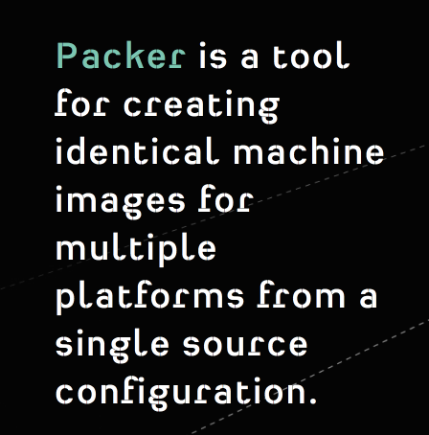
Build the VM with Packer

Slide 107
Host OS
Packer
build
boot2docker
mongo image
couch image
elastic image
Container
Vagrant
mongo
Docker provision run
Container
couch
Container
elastic

Slide 108
Vagrant.configure("2") do |config|
config.vm.box = "bt-b2d-#{BOX_VERSION}"
config.vm.box_url = "#{REPO}/bintray-boot2docker-vagrant/bt-b2d-#{BOX_VERSION}.box"
config.vm.provider :virtualbox do |vb, override|
vb.gui = false
...
end
config.vm.provision :docker do |d|
d.run "mongodb",
image: "#{DOCKER_REPO}bintray/mongo:dev",
args: "-p 27017:27017 -v #{HOST_DATA_FOLDER}/mongodb/log/:/data/log/ --privileged=true",
...
d.run "couch",
image: "#{DOCKER_REPO}bintray/couchdb:dev",
args: "-p 5984:5984 --sig-proxy=false -v #{HOST_DATA_FOLDER}/couchdb/log/:/usr/local/var/log/couchdb/”

Slide 109
"provisioners": [
...
{
"type": "shell",
"inline": [
"docker pull repo:80/bintray/mongo:dev",
"docker pull repo:80/bintray/redis:dev",
"docker pull repo:80/bintray/couchdb:dev",
"docker pull repo:80/bintray/elasticsearch:dev"
],
"pause_before": "30s"
}
],

Slide 110

How did we like it?

Slide 111
But…
Notes:
Pros:
Solves the problem!
Cons:
Devs ruin stuff
Recipes depend on state
Partial rerun is almost impossible
Replaying all the recipes takes ages

Slide 112
Still, some challenges
Updating the base box
Solved by timestamping
Deciding when to repackage the box
Developers Docker learning curve

Slide 113
How it works

Slide 114
How it works
Packer builds custom b2d image with base images preinstalled

Slide 115
How it works
Packer builds custom b2d image with base images preinstalled
Vagrant downloads the box from artifactory

Slide 116
How it works
Packer builds custom b2d image with base images preinstalled
Vagrant downloads the box from artifactory
Vagrant runs the b2d virtual box

Slide 117
How it works
Packer builds custom b2d image with base images preinstalled
Vagrant downloads the box from artifactory
Vagrant runs the b2d virtual box
Vagrant pulls & starts the containers

Slide 118
How it works
Packer builds custom b2d image with base images preinstalled
Vagrant downloads the box from artifactory
Vagrant runs the b2d virtual box
Vagrant pulls & starts the containers
Vagrant destroy keeps Base containers

Slide 119

No, Thank you!

